Slide 1

ERASMUS + CALL FOR APPLICATIONS 2025/2026
Mobility for Studies
Strada Maggiore 45, 13 January 2025

Slide 2
PURPOSE
The Erasmus+ Mobility for Studies progamme enables students to spend a period of study at another university that has entered into an agreement with the University of Bologna. Students are guaranteed full recognition of the learning activities completed abroad, on the condition that they were approved in advance by the Degree Programme Board. Moreover, students do not have to pay any additional enrollment fees at the host institute and they will receive a financial grant to support their mobility.

Slide 3

DESTINATIONS
Europe
Extra EU
UK and Switzerland
United Kingdom
Switzerland
26 Member States
+
6 Non-EU European States
1.06.2025 – 31/07/2026
1.06.2025 – 31/07/2026
1.06.2025 – 31/07/2026

Slide 4
ENTRY INTO PARTNER COUNTRIES
If you choose to go on Erasmus to a Partner Country, including the United Kingdom, you will need to obtain information on:
the entry visa and health insurance (information available from Italian embassies or consulates);
the costs of the visa, health insurance, and any other expenses required for entry, cannot be covered by the University of Bologna;
the language requirements necessary to issue the invitation letter for obtaining the visa.

Slide 5
ACTIVITIES ABROAD
Learning activities (courses) and related assessment tests (exams)
Attendance (only learning activities not yet completed at UNIBO will be deemed valid and, in any case, only if agreed to by the Degree Programme Board when approving the Learning Agreement)
Preparation of the master degree thesis and/or PhD thesis
Curricular internship (only if included as a part of the course programme and if the host university agrees to manage the internship)
Check with the professor responsible for the exchange about the possibility of carrying out thesis preparation or internship activities).

Slide 6
FINANCIAL GRANT
The Erasmus grant is a contribution to the higher expenses incurred during the period outside Italy. It is calculated based on the destination country, the actual days spent at the partner university, and it is compulsory to recognize at least one academic activity at the University of Bologna after your return.
In case of non-recognition, the financial grant must be returned.

Slide 7
TYPES OF FUNDING
→ destination EU
EU
Integration Unibo/MIUR
€ 300/350 per month (destination country/number of days spent abroad; it is paid in full at the start of the Erasmus)
The amount will be based on your family income; see Attachment 5 of the call for application for more details on the grant amounts.
Special Funding EU
Grants for students with special physical, mental or health needs (to be communicated upon acceptance of the exchange place).
Disbursement: 50% after uploading the arrival certificate; 50% upon return, based on the actual duration of the exchange.

Slide 8
Green Travel
Travels towards the host university made with sustainable means of transportation (bus or train) will be partially covered by a grant of €50.

Slide 9
TYPES OF FUNDING
→ Extra-European destinations
Contribution for living costs
Travel contribution
€ 700 per month (actual number of days spent abroad)
The amounts are established by the Erasmus + Programme based on the distance in kilometres between Bologna and the central campus of the host university. The amounts are spending limits, so the student will be reimbursed for the actual cost of the ticket up to the maximum amount indicated for each destination (details on page 4 of the call).

Slide 10
ELIGIBILITY REQUIREMENTS
Be enrolled at the University of Bologna in the 2024/2025 academic year.
Possess adequate language skills (certificate/CLA test)
Book the CLA test by 17 Janurary at 1p.m.!!!!
Present a letter with a possible study plan to be followed at the host university and a motivation statement.
Renew UNIBO enrollment for the 2025/2026 academic year according to the Unibo deadlines.

Slide 11
INCOMPATIBILITIES
Students who apply for this call of application:
Cannot exceed 12 months of Erasmus mobility allowed for each study cycle (L, LM, PhD), including the months already used in the Erasmus+ programme (Erasmus, Erasmus Traineeship). For single-cycle degrees, the limit is 24 months.
Cannot receive, during the same period they are benefiting from the Erasmus+ funding, any other type of EU or Unibo funding for mobility abroad (Overseas, Departmental Thesis Abroad call, etc.).

Slide 12
LANGUAGE REQUIREMENTS
If the call of application does not indicate an higher levels the minimum level of language skill is required: A2 of CEFR.
Check the language requirements requested by the host university on its website (web page for Incoming Erasmus students), these might be higher than the level required by Unibo.
Pay attention to this call’s attachements:
Attachment 1 – exemptions of language assessments
Attachment 3 – CEFR Table
Attachment 4 – degree programs taught entirely in English

Slide 13
LANGUAGE REQUIREMENTS
Information on the enrollment for CLA tests on Studentionline: https://centri.unibo.it/cla/it/test-linguistici/test-erasmus-studio
CLA test simulation: https://simulatest-cla.unibo.it/
In case of doubts on language requirements, send an email to: aform.accertamentilinguistici@unibo.it

Slide 14
CLA TEST
It is possible to sit the test for up to two languages, and, for each language, only once. Exchanges with dual language: it is possible to take the test in one of the two languages.
The test can be taken at any Unibo campus.

Slide 15
LANGUAGE REQUIREMENTS/host uni
The Erasmus+ language requirement is not limited to the requirement for access to the call but also includes the requirement for acceptance by the partner universities (each host university has its own requirements).
!!!ALWAYS CHECK THE LANGUAGE REQUIREMENTS IN THE OFFER AND ON THE PARTNER UNIVERSITY’S WEBSITE FOR ERASMUS INCOMING!!!
Failure to meet the requirement level set by the Unibo exchange offer causes the rejection of your application.
Failure to meet the level required by the partner university will cause the rejection of your application by the partner university.

Slide 16
CHOICE OF DESTINATION
Read the offers by logging in with your credentials on AlmaRM
For Extra-EU locations: discipline area > «multidisciplinary offers»
Choose from the available offers based on:
Required language skills
Verify the academic activities offered and the application deadlines for the foreign university’s application procedure (host university’s website)
Interview with the proposing professor ➔ to be done before submitting the application (the interview is often mandatory!)

Slide 17
VACANCIES
Duration: from 2 to 12 months (minimum 60 days)
Open to: L/LM or both; degree programs with priority
Note: the enrollment year refers to the year in which the stay takes place (a.y. 2025/2026)
Language: specified in the exchange detail
Interview with the exchange’s professor: specified in the exchange detail
Note: Offers marked with “offer not yet confirmed by the partner university” indicate that the renewal of the Erasmus agreement is still in progress, but it is almost certain that they will be confirmed.

Slide 18
«FUTURE CAREER»
A.Y.2024/25 enrolled in the 3° year/F.C. L
A.Y. 2025/26 departure in the 1° year LM
AlmaRM « future career» option
Departure in the 2° semester LM
Apply to exchanges available to the chosen Master’s program (LM)
Note: the student on mobility cannot obtain the final degree before the completion of the study period abroad and the recognition of the activities undertaken.

Slide 19
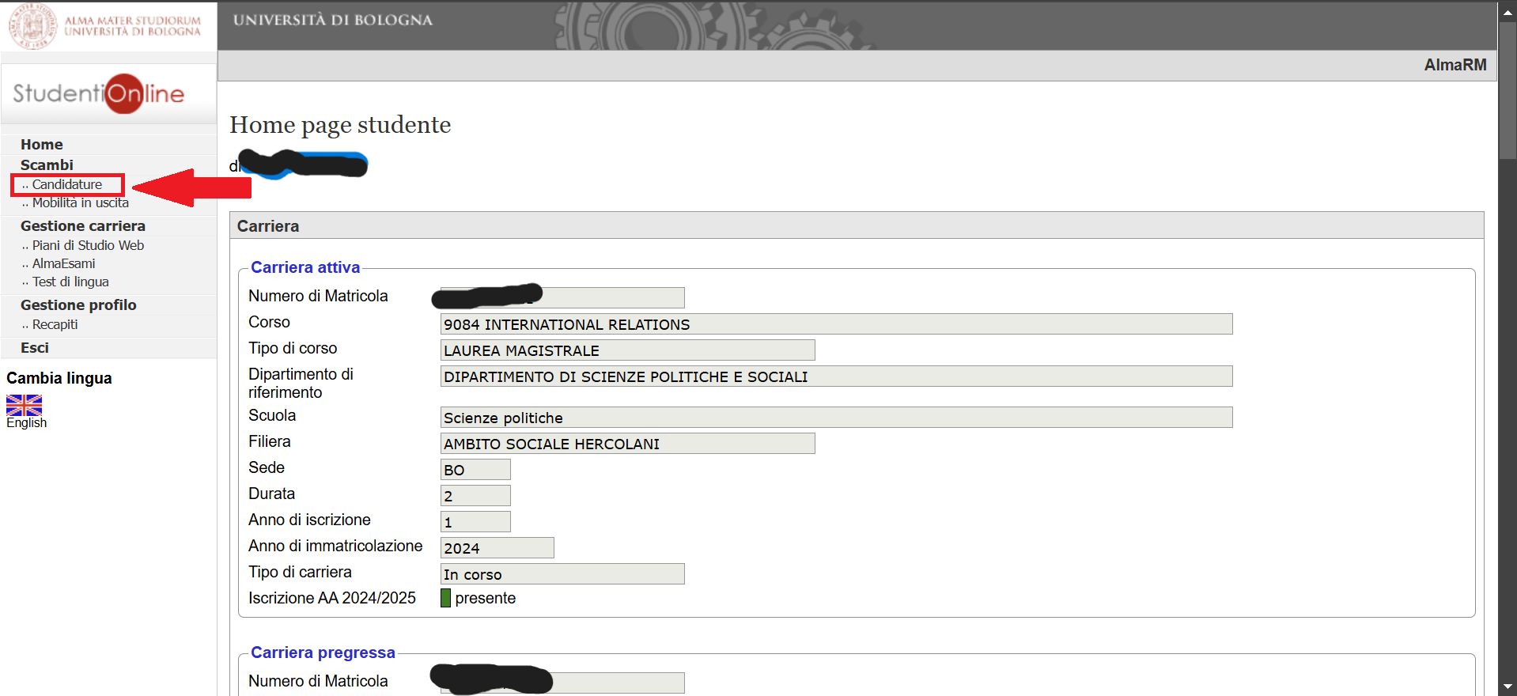

Slide 20
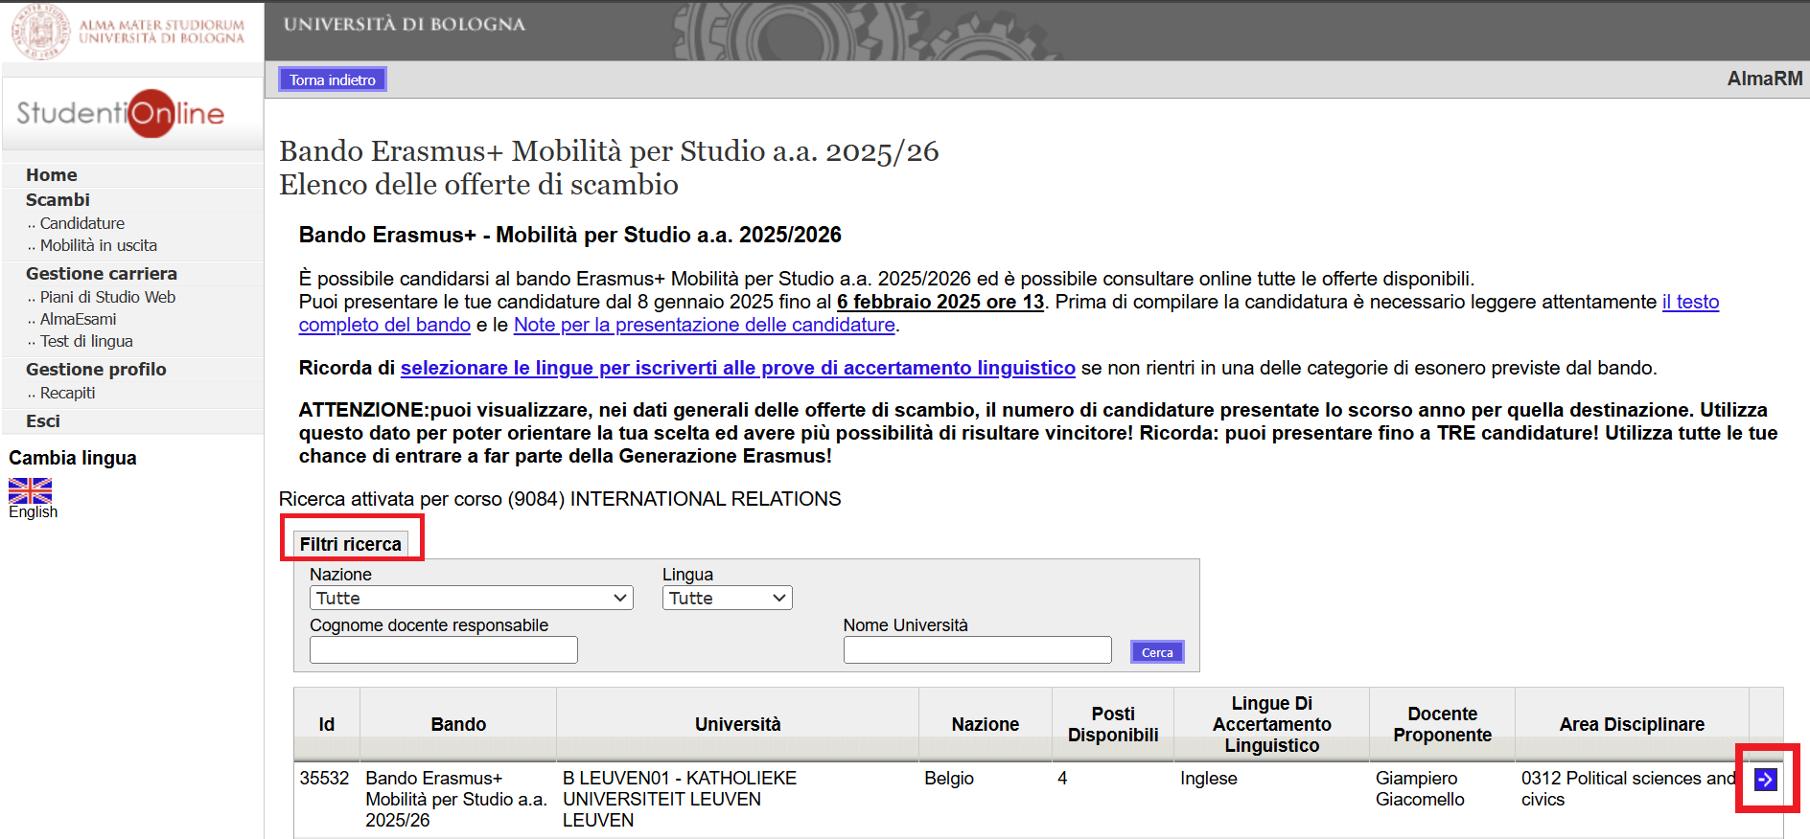

Slide 21
BEFORE APPLYING
Read the call and verify the required requirements
Register for the CLA language test*
Interview with the proposing professor*
Verify any language requirements set by the partner university for Erasmus incoming/exchange students and the deadlines for the application procedure (host university website; International Relations Office)
Check the courses at the host university
e.g.: are there for Erasmus students in English (Northern Europe, Eastern Europe)
Courses restricted to Erasmus students, etc.
Visa and residence permit procedures in the foreign country.

Slide 22
DOCUMENTS TO ATTACH
Study plan = list of courses identifies at the host university (not definitive, as the final list will be included in the Learning Agreement in a few months) + academic and cultural motivations + any study/work experiences abroad
Language certificate (if possessed)
Certificates related to experiences abroad (if any) or additional language skills that you wish to present to the professor
Self-certification of previous studies (only if completed at another university)
ONLY PDF FORMAT; CREATE SINGLE FILES FOR MULTI-PAGE DOCUMENTS, SIGN ALL DOCUMENTS.

Slide 23
APPLICATION PRESENTATION
The application must be exclusively presented online on AlmaRm by
Thursday 6 February, at 1 p.m.
Studenti On-line > Mobilità Internazionale AlmaRM
Note: Before starting, consult the PDF guide “Notes for filling in applications”
Application for a maximum of three different vacancies (they could also be all from the same exchange coordinator).
Any certificate and documents must be attached in PDF format.
If you have more than one degree programme at Unibo, you can apply for Erasmus for only one degree programme.
Note: It is possible to save the application as a draft to continue filling it out later («save a draft»). To submit the application, you must select «save final version» by the deadline of 6 February.

Slide 24
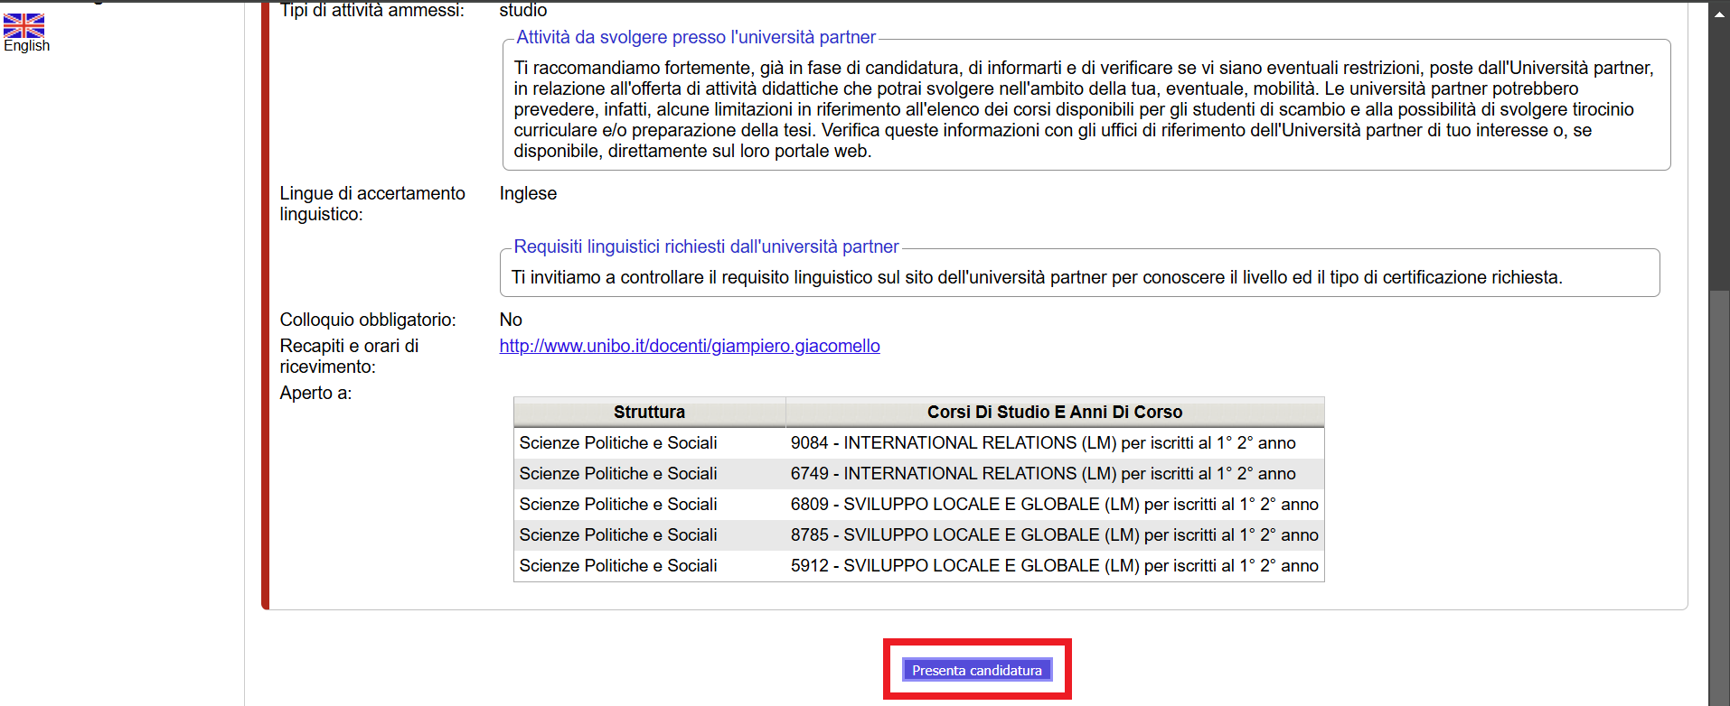

Slide 25
END OF APPLICATION
Once an application has been submitted, an e-mail will be sent to the student’s institutional e-mail address (name.surname@unibo.studio.it) as confirmation that the application has been successfully uploaded.

Slide 26
AWARD CRITERIA
A. 0 – 40 points → evaluation by the exchange coordinator:
compatibility of the study plan
motivations indicated in the application
interview, if compulsory
language skills
other elements specified by the student in the application or during the interview.
B. 0 – 60 points → academic progress based on regularity of study, course credits and marks registered by 12 February 2025, 11.59 p.m.
Students enrolled in their first year of a master degree: the calculation of points comprises 6/7 of the previous course of study and 1/7 of the current one.
Students with a foreign degree: evalutation by a special commission.
Non idoneo (Not eligible) = students who will get 0 points by the exchange coordinator

Slide 27
ACCEPTANCE
The ranking lists will be published online on:
Thursday 6 March 2025
Successful students must confirm their acceptance via the AlmaRM profile by:
Wednesday 12 March 2025 at 1 p.m.
It is possible to accept only one Erasmus vacancy.
Attention notice: after this deadline, successful students that have will not accepted will be automatically deleted from the rankings for non-accepted Erasmus places.

Slide 28
SHORTENING/EXTENSION
It is possible to request the shortening of the Erasmus period when accepting the place by selecting only one semester, or (recommended) request the shortening during the Erasmus period.
It is also possible to request an extension during the Erasmus period (further details in the winners’ guide)

Slide 29
BEFORE DEPARTURE
Fulfill the administrative requirements (application procedure) of the partner university*: application form, language certificates, etc.
Responsible Office: Partner University
Prepstr and have the Learning Agreement approved by the Degree Programme Board.
Responsible offices: proposing professor, International Mobility Office, Degree Programme Board.
Sign the Mobility Contract
Responsible Office: AFORM– European Mobility Office
* The final decision regarding the admission of successful students rests with the host universities, and in case of rejection, the University of Bologna does not provide reallocation.

Slide 30
DEADLINES
Deadlines Calendar (attached): https://bandi.unibo.it/s/diri/bando-erasmus-studio-a-a-2025-26/bando/calendario-delle-scadenze-2025_26_it.pdf/@@download/file/CALENDARIO%20DELLE%20SCADENZE%202025_26_IT.pdf
Deadline for the submission of applications:
6 February 2025
Publication of rankings online (AlmaRM).
6 March 2025
Deadline to accept a placement (the procedure will be entirely online).
12 March 2025, 1 p.m.
Publication of updated rankings.
13 March 2025
Deadline to accept a placement with reference to the updated rankings (the procedure will be entirely online).
26 March 2025, 1 p.m.

Slide 31
CONTACTS
International Mobility Office Political Science
Via Filippo Re 8 Bologna
E-mail: mobility.politicalscience@unibo.it
Tel. 051 2084094
AFORM – Mobility for Study Office
Palazzina della Viola
Via Filippo Re n.4
E-mail: erasmus@unibo.it
Tel. 051 2099357

